Slide 1
Revenue
2M
Executive Overview
Quarter and Month Name
Power BI Desktop
V  Q1
January
February
March
O Q2 O Q3 O Q4
V V V
Gross Profit
1.07M
Gross Margin
43.62%
Total Units
141K
V V V
Revenue by Category
Revenue by Product_Category
0.3M
0.27M
0.2M
0.20M
0.19M
0.19M
0.18M
0.16M
0.16M
0.16M
0.15M
0.15M
0.15M
0.14M
0.12M
0.12M
0.1M
0.08M
0.0M
0.01M
Action Figures
Toy Vehicles
Puzzles
Baby & Toddler
Outdoor Play
STEM Kits
Arts & Crafts
Educational
Dolls
Board Games
Pretend Play
Card Games
Building Blocks
Plush
Model Kits
Collectibles
Revenue Trend
Gross Profit Trend
Revenue by Quarter, Month Name and Day
Gross Profit by Quarter, Month Name and Day
32K
31.4K
31.9K
14.1K
30.6K
14K
13.6K
30K
29.6K
13.3K
28.9K
28.9K
28.8K
28.5K
13K
12.8K
12.8K
28K
28.0K
27.7K
28.0K
28.0K
12.5K
12.6K
12.4K
12.5K
27.6K
27.4K
27.3K
27.3K
27.5K
27.5K
27.2K
12.0K
12.0K
12.1K
12.1K
12.0K
12.0K
12.1K
12.1K
26.9K
26.8K
26.9K
27.6K
26.4K
26.5K
12K
11.8K
11.8K
11.8K
26K
26.8K
25.7K
26.8K
26.2K
26.2K
25.7K
11.9K
11.9K
11.3K
11.1K
10.7K
11.6K
11.6K
11.4K
11.5K
11.5K
11.5K
25.6K
25.0K
25.9K
25.8K
26.2K
11.7K
11.2K
25.5K
25.3K
25.5K
25.1K
25.7K
11K
11.2K
11.1K
11.1K
11.1K
11.3K
11.3K
25.1K
24.3K
11.0K
10.5K
11.1K
10.9K
24K
1 2 3 4 5 6 7 8 9 10 11 12 13 14 15 16 17 18 19 20 21 22 23 24 25 26 27 28 29 30 31 1 2 3 4 5 6 7 8 9 10 11 12
January February
Q1
1 2 3 4 5 6 7 8 9 10 11 12 13 14 15 16 17 18 19 20 21 22 23 24 25 26 27 28 29 30 31 1 2 3 4 5 6 7 8 9 10 11 12
January February
Q1

Slide 2














Store Performance
Power BI Desktop
Store Revenue Contribution
Store_Location
O Airport
O Commercial O Downtown O Mall
Residential
O Suburban
Store Revenue Share by Store_Name
Revenue
998K
Gross Profit
435.51K
Gross Margin
43.63%
Spark & Play Omaha
0.0095
Giggles & Gadgets Mesa
0.0091
Bluebird Toys Naperville
0.0091
Wonderland Toys Newport News
0.0090
Revenue and Gross Margin Trend
City Lights Toys Springfield
0.0086
Revenue and Gross Margin by Store_Name
Wonderland Toys Boulder
0.0079
100K
93K
90K
90K
89K
85K
44.78%
Rocketship Toys Cleveland
0.0077
78K
76K
44.29%
70K
43.54%
70K
68K
43.47%
Wonderland Toys Knoxville
0.0071
43.83%
44%
50K
43.24%
43.48%
Bluebird Toys Gainesville
0.0071
43.32%
43.14%
City Lights Toys Columbia
0.0069
42.84%
Rainbow Toy Market Sacramento
0.0068
0K
Spark & Play Omaha
Giggles & Gadgets Mesa
Bluebird Toys Naperville
Wonderland Toys Newport News
City Lights Toys Springfield
Wonderland Toys Boulder
Rocketship Toys Cleveland
Wonderland Toys Knoxville
Bluebird Toys Gainesville
City Lights Toys Columbia
42%
Space Ranger Toys Tempe
0.0064
Tiny Treasures Toys Riverside
0.0061
Revenue
Gross Margin
0.000
0.005
0.010
Store Sales Performance
Total Units, Revenue and Gross Profit by Store_Name
Store Revenue vs Gross Margin
Revenue, Gross Margin and Gross Profit by Store_Name
100K
45%
Revenue
80K
Gross Margin
44%
60K
43%
3500
4000
4500
Total Units
5000
5500
60K
70K
Revenue
80K
90K

Slide 3

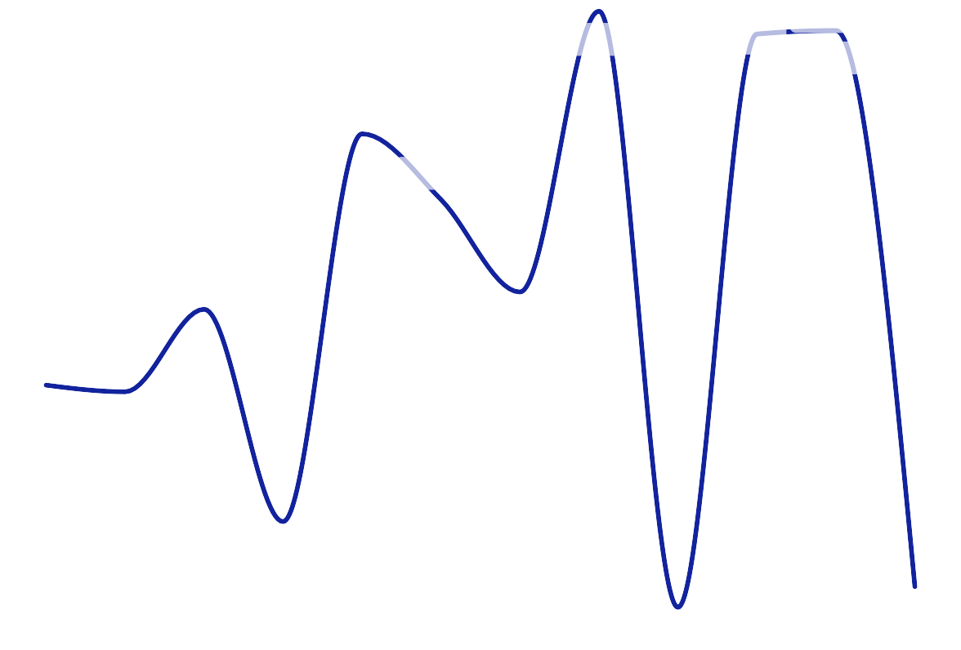
Top Product Revenue Trend
Product Performance Matrix
Product_Category
Power BI Desktop
O Action Figures
O Arts & Crafts
Baby & Toddler O Board Games O Building Blocks O Card Games
O Collectibles
O Dolls
O Educational O Model Kits O Outdoor Play
Revenue by Quarter, Month Name and Product_Name
Product_Name | Total Units | Revenue | Gross Profit | Gross Margin
Adventure Robot | 2209 | 78420 | 34,084.87 | 43.46%
City Plush Bear | 3395 | 37107 | 10,218.95 | 27.54%
Deluxe Builder Set | 3341 | 55260 | 28,766.01 | 52.06%
Deluxe Science Lab | 2515 | 70345 | 34,128.55 | 48.52%
Dino Explorer Kit | 2955 | 36287 | 10,017.45 | 27.61%
Eco Art Kit | 4367 | 27730 | 10,611.81 | 38.27%
Galaxy Space Ship #133 | 3869 | 42056 | 19,228.93 | 45.72%
Pro Board Game | 3565 | 37040 | 17,254.60 | 46.58%
Pro Explorer Kit #7 | 3474 | 36442 | 12,228.48 | 33.56%
Rainbow Board Game | 3091 | 54711 | 22,842.49 | 41.75%
Retro Builder Set | 3495 | 37641 | 20,131.20 | 53.48%
Retro Explorer Kit | 3966 | 29428 | 8,566.56 | 29.11%
Rocket Sticker Book | 2696 | 78804 | 38,903.28 | 49.37%
Smart Card Deck | 2698 | 81884 | 41,603.16 | 50.81%
Smart Plush Bear | 3340 | 45224 | 16,299.20 | 36.04%
Total | 48976 | 748380 | 324,885.54 | 43.41%
8.3K
8.0K
7.8K
8K
7.6K
7.6K
7.4K
7.1K
7.3K
6.9K
7.0K
7.3K
7.0K
6.5K
6.2K
6.7K
6.7K
6.7K
6.2K
7.2K
6.9K
6.6K
6.2K
5.5K
6.7K
6.8K
6.0K
6.3K
6.9K
6.6K
6.0K
6.4K
6.1K
5.6K
6.6K
6.8K
6.5K
6K
5.9K
5.3K
5.5K
4.2K
5.5K
5.6K
5.3K
6.0K
5.6K
4.2K
5.1K
5.2K
4.9K
4.8K
4.9K
5.6K
4.7K
5.1K
4.0K
4.3K
5.2K
4.4K
4K
January
February Q1
March
April
May Q2
June
4.4K
August Q3
November Q4
July
September
October
December
Adventure Robot
Deluxe Builder Set
Deluxe Science Lab
Rocket Sticker Book
Smart Card Deck
Category Performance
Revenue and Gross Margin by Quarter and Month Name
Top Products by Revenue & Gross Profit
Revenue and Gross Profit by Product_Name
70K
64K
65K
64K
64K
43.67%
62K
43.7%
82K
61K
63K
62K
61K
60K
63K
80K
79K 78K
60K
59K
43.57%
43.6%
70K
50K
43.50%
43.5%
60K
55K
55K
40K
43.39%
43.41%
43.4%
45K
43.31%
42K
39K
42K
38K
30K
43.3%
40K
34K 34K
37K
37K
36K 36K
43.31%
29K
1
1
1
29K
28K
Product & Category Performance
20K
43.2%
23K
19K
20K
1
43.18%
20K
16K
0K
7K
2K
0K
10K
43.11%
43.1%
1
9K
1K
43.09%
0K
43.0%
0K
January
February
March
April
May
June
July
August
September
October
November
December
Smart Car…
City Plush Bear
Eco Art Kit
Adventure Robot
Smart Plush Bear
Retro Builder Set
Pro Board Game
Dino Explorer Kit
Deluxe Builder Set
Pro Explorer Kit #7
Retro Explorer Kit
Rocket Sticker Book
Deluxe Science Lab
Rainbow Board Game
Galaxy Space Ship #133
Q1
Gross Margin
Q2
Q3
Q4
Revenue
Revenue
Gross Profit

Slide 4

Store Inventory Health & Risk
Store Inventory Risk
Store_Location
Store_City
Power BI Desktop
O Airport
O Commercial
Downtown
O Mall
O Residential
O Suburban
O Akron, OH
O Ann Arbor, MI O Arlington, TX O Asheville, NC O Aurora, CO
O Baltimore, MD
O Birmingham, AL
Store_Name | Sum of Replenishment_Risk_SKUs | Sum of Overstock_Risk_SKUs | Sum of
Adventure Toys Virginia Beach | 0 | 7
Bluebird Toys Lexington | 0 | 0
Board Game Barn Minneapolis | 7 | 0
Board Game Barn St. Petersburg | 1 | 20
Board Game Barn Toledo | 0 | 0
Bright Star Toy Shop Birmingham | 11 | 1
Cedar Toy Corner Montgomery | 20 | 0
City Lights Toys Raleigh | 0 | 13
City Lights Toys Stockton | 7 | 4
Classic Toy Chest Modesto | 3 | 2
Creative Play Toys Huntsville | 0 | 0
Dinosaur Dreams Toys Aurora | 0 | 0
Dinosaur Dreams Toys Glendale | 8 | 0
Giggles & Gadgets Lubbock | 2 | 17
Happy Hippo Toys Durham | 0 | 3
Kids Quest Toys Plano | 5 | 1
Kids Quest Toys Winston-Salem | 5 | 0
Little Sprouts Toys Peoria | 0 | 4
Maple Street Toys Louisville | 8 | 0
Mini Makers Asheville | 11 | 0
Mountain Trail Toys Pittsburgh | 9 | 2
Neighborhood Toy Co. Garland | 0 | 0
Neighborhood Toy Co. Rochester | 0 | 3
Neighborhood Toy Co. San Bernardino | 2 | 2
Ocean Wave Toys Wichita | 0 | 8
Playtime Emporium Los Angeles | 12 | 2
Puzzle Planet Ann Arbor | 0 | 7
Puzzle Planet Fresno | 0 | 3
Puzzle Planet Las Vegas | 0 | 12
Rainbow Toy Market Baltimore | 0 | 2
Rainbow Toy Market Tampa | 0 | 2
Space Ranger Toys Nashville | 0 | 2
Space Ranger Toys Oceanside | 0 | 20
Spark & Play St. Paul | 0 | 1
Storybook Toys Fort Collins | 0 | 30
Total | 153 | 216
Inventory Stock
128K
Sum of Units
223K
Stock vs Sales by Store
Sum of Units, Sum of Stock_On_Hand and Revenue by Store_Name
Category Inventory Risk
Sum of Replenishment_Risk_SKUs and Sum of Overstock_Risk_…
Action Figures
153
216
Arts & Crafts
153
216
Baby & Toddler
153
216
3000
Board Games
153
216
Building Blocks
153
216
Card Games
153
216
Sum of Stock_On_Hand
Collectibles
153
216
Dolls
153
216
2500
Educational
153
216
Model Kits
153
216
Outdoor Play
153
216
Plush
153
216
2000
Pretend Play
153
216
Puzzles
153
216
STEM Kits
153
216
Toy Vehicles
153
216
3000
3500
4000
4500 5000
Sum of Units
5500
6000
6500
0
Sum of Replenishment_Risk_SKUs
100 200
Sum of Overstock_Risk_SKUs

Slide 5
Business Insights & Recommendations
Business Insights– Key Insights
01 | Sales Performance
Revenue is strongly associated with sales volume, with a store-level correlation of 0.975 between Units Sold and Revenue.
02 | Product & Category
High-revenue categories do not always have the highest gross margins. Some high-volume categories combine strong revenue contribution with relatively lower margin.
03 | Store Performance
Differences between stores are primarily reflected in sales volume, while gross margins remain broadly consistent across stores.
04 | Inventory Risk
The inventory analysis identified both replenishment-risk and potential-overstock SKU groups, highlighting opportunities for more targeted inventory management.
Business Insights– Recommendations
01 | Margin Optimisation
Review pricing, discounting and product costs for high-revenue, lower-margin categories.
02 | Inventory Management
Investigate store-SKU combinations with replenishment or potential-overstock risk before making inventory decisions.
03 | Product Management
Prioritise products that generate strong revenue and gross profit, while reviewing high-volume products with relatively low margins.
04 | Store Management
Use sales volume and revenue together when investigating differences in store performance, rather than focusing on margin alone.

